Slide 1

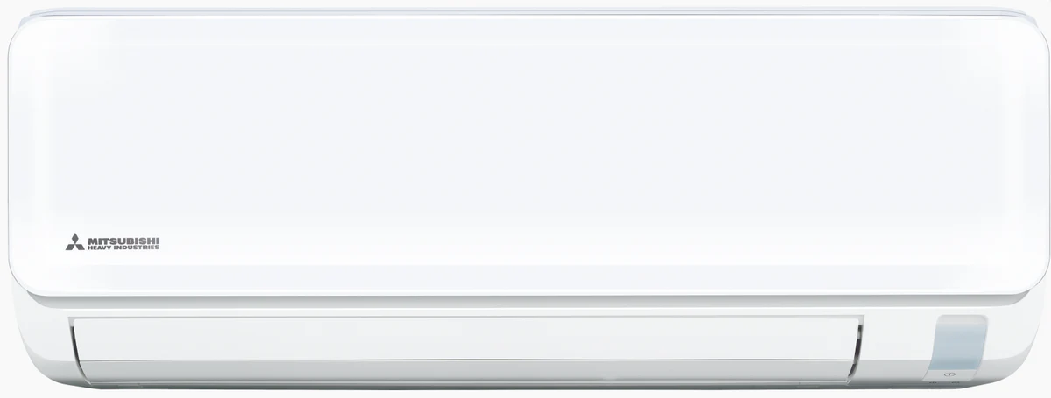
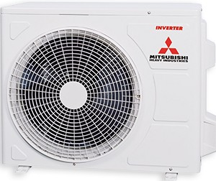
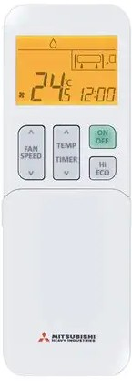
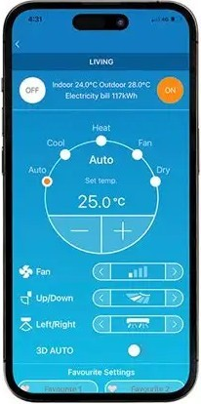
Mitsubishi Heavy Industries Ciara Series
Cooling: 9.0 kW
Heating: 10.0 kW
Installation Included
Low noise operation
Built-in Wi-Fi

